Slide 1
AI for Mineral Processing Optimisation
Bonga Manzini
02 October 2025
UDS DIGGERS

Slide 2
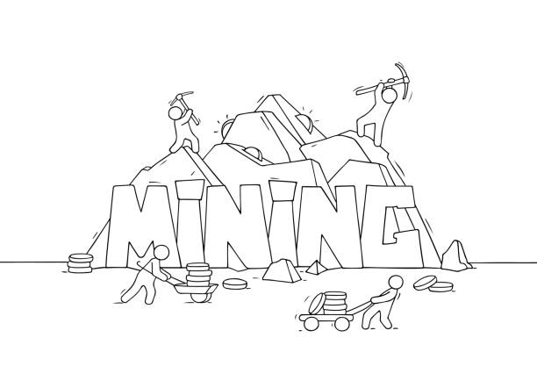
Agenda
Introduction
Problem Understanding & Context
Proposed Solution
Impact & Feasibility
Development Journey & Technical Highlights
Future Outlook
Closing

Slide 3

Team Members
Bonga Manzini
Team Lead

Slide 4
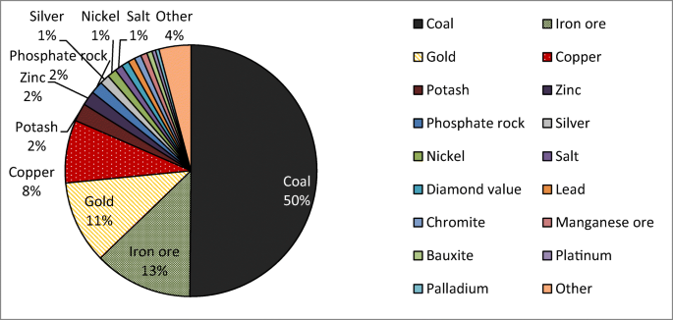
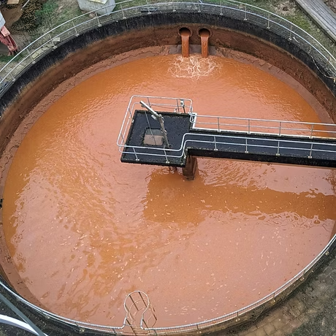
Problem Understanding & Context
Notes:
Flotation circuits are like the heart of a mineral plant – they separate valuable minerals like iron from waste. But the problem is, these circuits are highly unstable because the ore and process conditions keep changing all the time.
This instability means:
Mines lose valuable iron instead of recovering it.
They use more energy and chemicals than needed.
The process becomes harder to control for operators.
Overall, mining becomes less profitable and less sustainable.
Even small improvements in stability and recovery can save millions and cut waste.

Slide 5
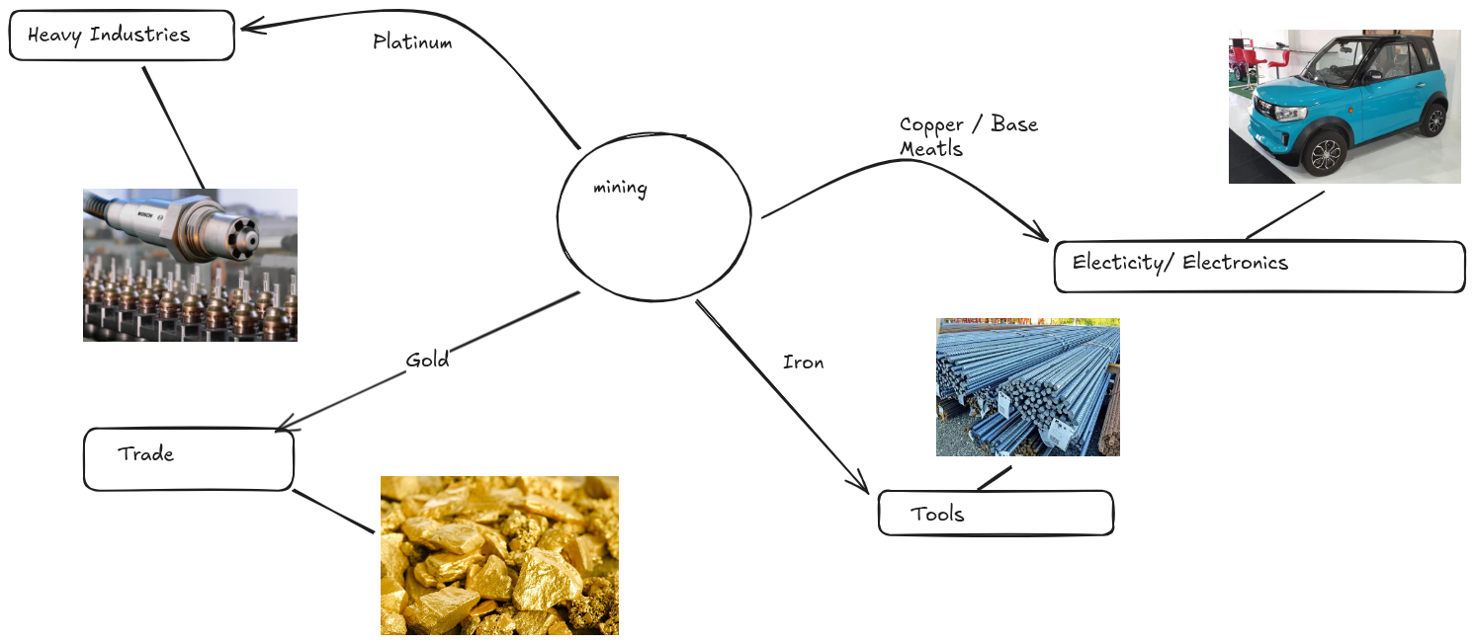
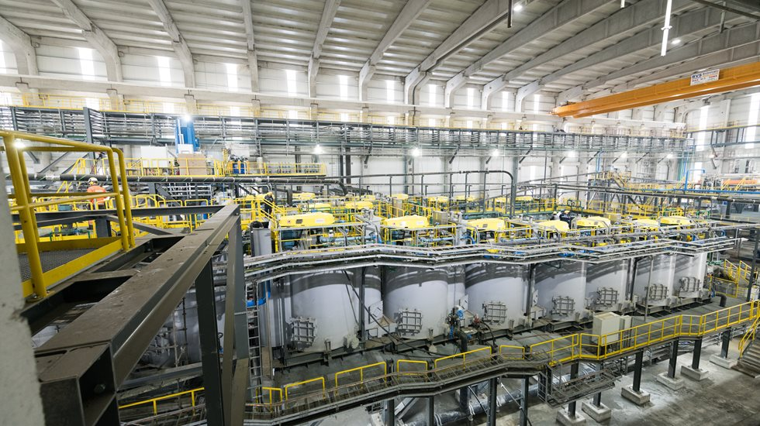

Slide 6
Air Flow Instability
Ore Changes Too Quickly
The quality of ore coming in (% Iron, % Silica) changes every few minutes.
These sudden shifts make it hard to keep recovery stable.
The froth layer depends on steady air injection.
If one column gets too much or too little air, recovery becomes uneven across the circuit.
Chemical Dosages are Tricky
Late Reactions to Problems
Starch (depressant) and Amina (collector) must be dosed just right.
Even small mistakes in flow rates can cause big swings in concentrate quality.
Sensors log data every 20 seconds, but operators often notice issues only after performance drops.
By then, valuable minerals are already lost.
Unstable Pulp Chemistry
pH and pulp density are like the “health check” of the flotation process.
If they drift outside the right range, bubbles can’t capture minerals effectively.

Slide 7
Problem | Old way
Ore quality changes every few minutes | Manual adjustments by operators, often too late
Chemical dosing is very sensitive | Fixed rules or set points that cant keep up
Air flow is unstable across columns | Simple PID loops that treat each column
Huge amounts of data collected | Mostly ignored or only used for logging
Recovery rates fluctuate | Minerals are lost, energy and chemicals wasted

Slide 8
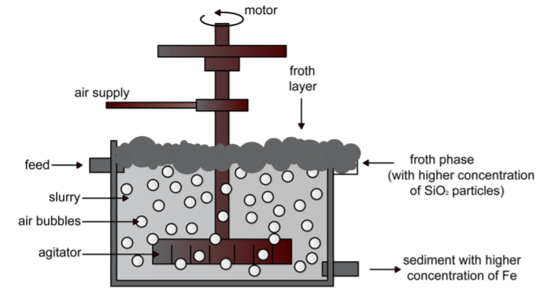
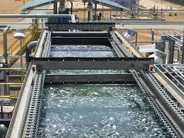
Propsed Solution

Slide 9
01
03
Previous
Data
Now use real data
Find historical data, that has the inputs and the results
Now use real data, and now since you trained the ai, the inputs will give you the results and viceversa
02
Train the Ai
04
Get real results
Use the LinerRegression/Random Forest Model to help it understand
The results will be as accurate as the information you trained it with and itll be able to be malleable with real data

Slide 10
01 Less energy wasted
No more unnecessary energy wasted and lost
02 Less money wasted
No more unnecsary expenditure.
03 A safer environemt
Since you know how to do accurately, youll be saving the enviroment.

Slide 11
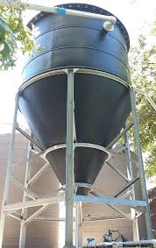
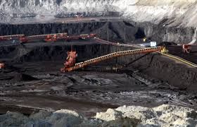
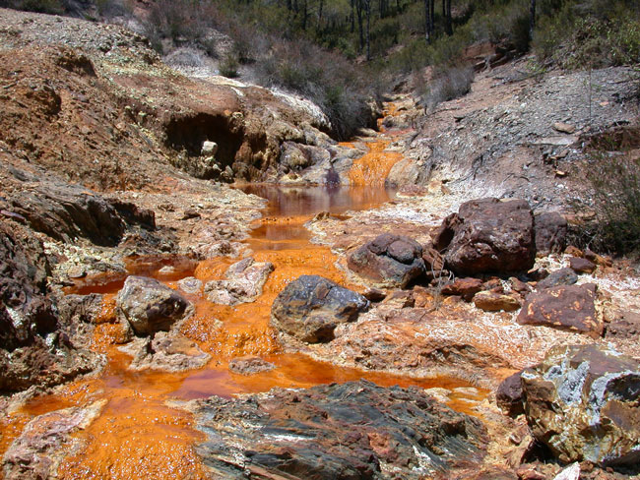
impact & feasibility

Slide 12

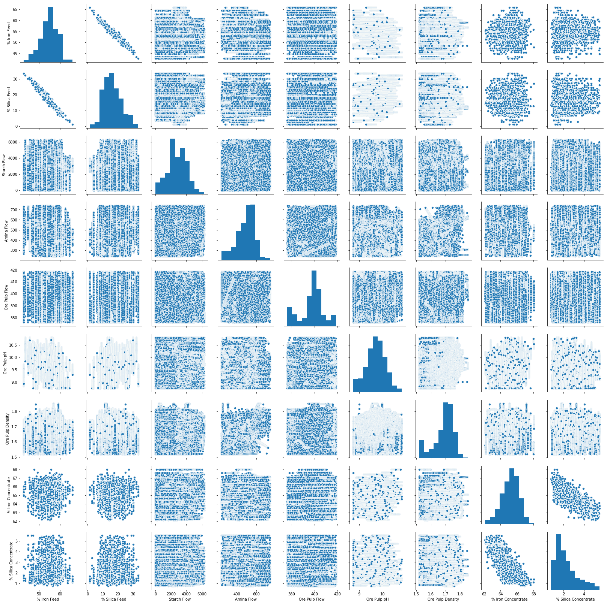
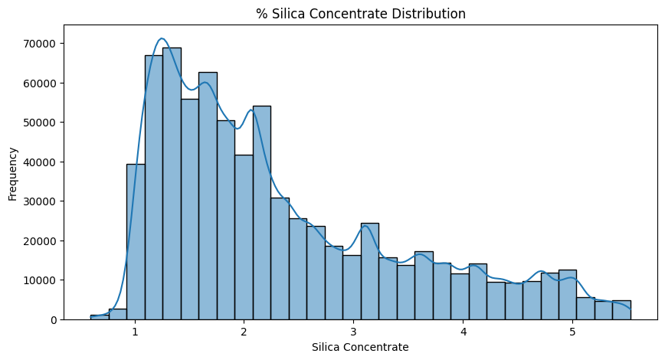
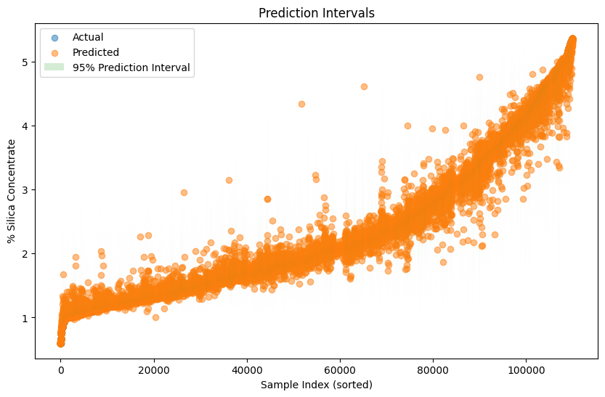
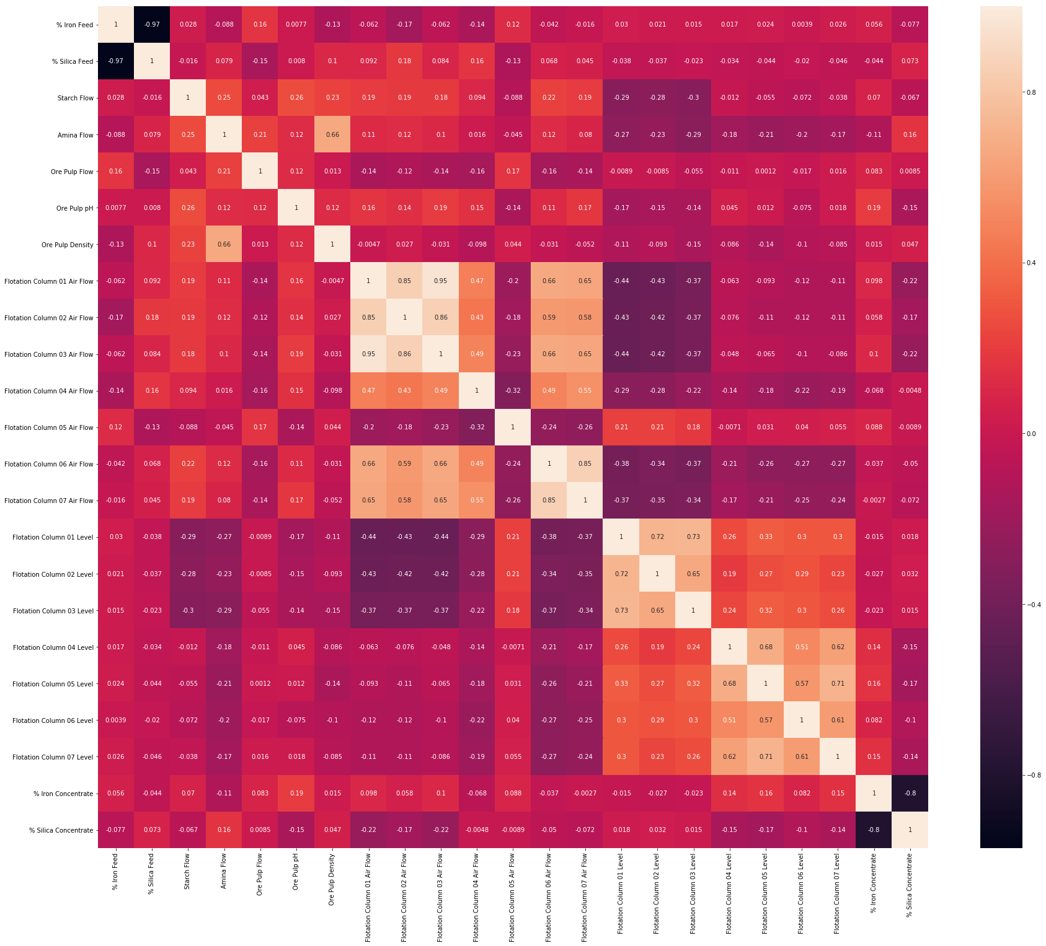

Slide 13
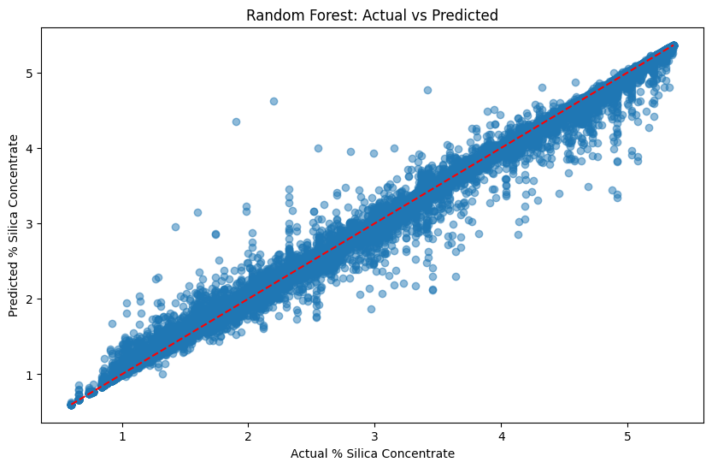
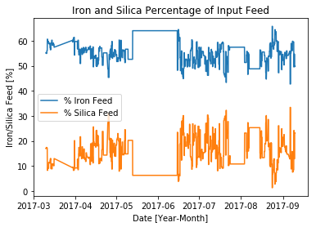

Slide 14
We can still save the world. We dont need to terraform mars
- Neil Degrasse TYson

